Slide 1
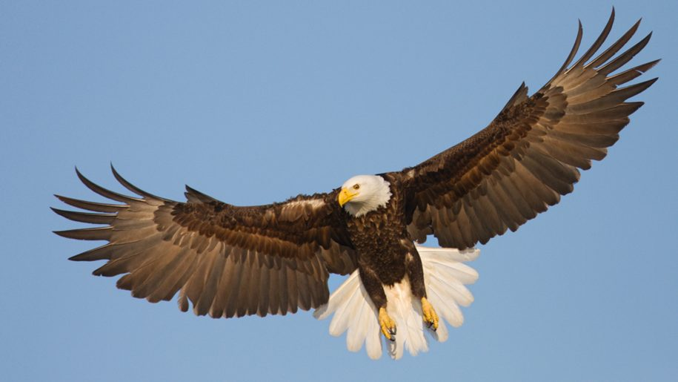

Eagle
Smart Monitoring Solution
Nishi
Arnav
Harsha
Arindam

Slide 2
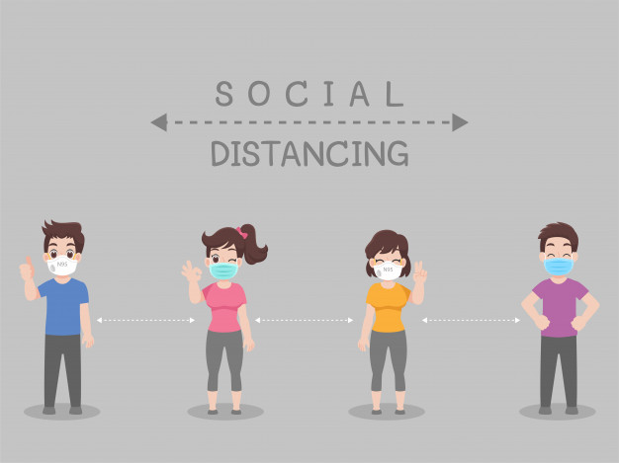



COVID-19 CRISIS Management – Challenges
Venturing out only for essential services
Social distancing in public places
Ensure emergency
support at all times

Slide 3









Our Solution – EAGLE
Key Features
Monitors social distancing compliance through AI powered vision
Activity tracking in public places
SOS Response automation

Slide 4
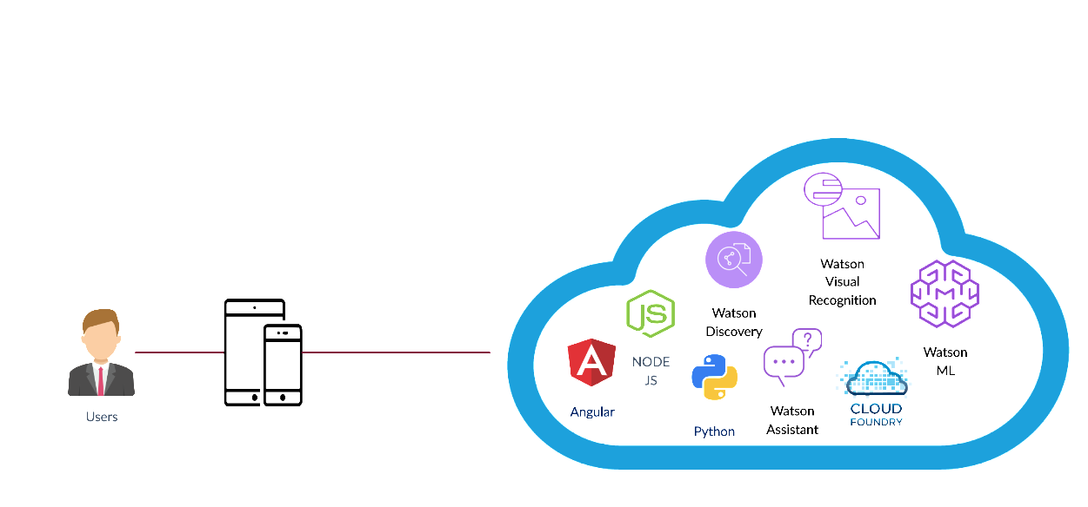
Solution components

Slide 5
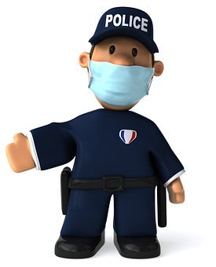
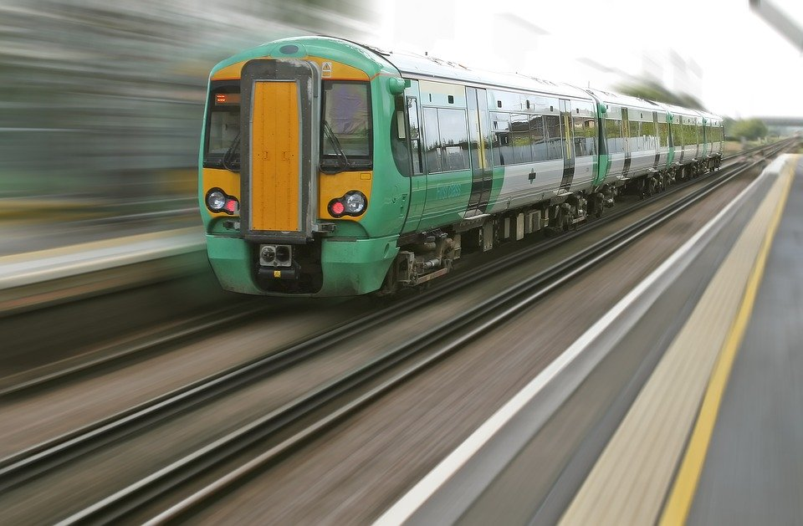
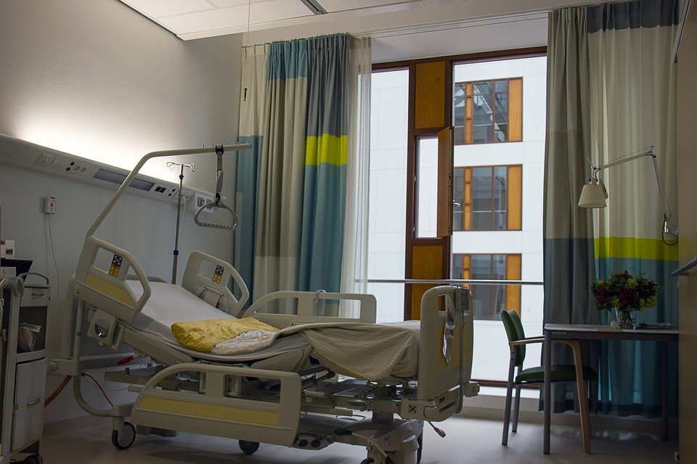
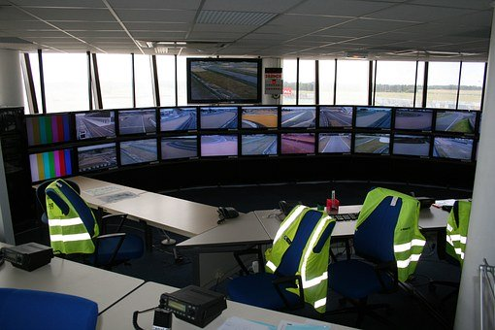
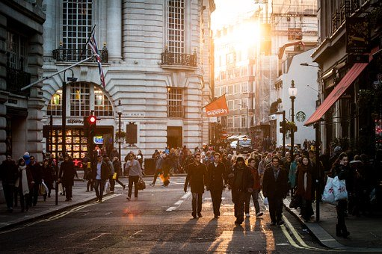
Benefits
Automated Surveillance
Optimizing transport facilities
Optimizing shopping hours
Ensure timely assistance
Latest news at your finger tips
Business Operations
Front Office
Technology
Organisation & Talent

